Slide 1


DO CONNECT APP: A revolutionary solution for mankinds questions: An Overview
Project by Joshua Gardner , Juan David
Ppt: Jong Kim

Slide 2




DO CONNECT overview and features: learning unlocked.
When answers are needed, they are needed fast and accurately. This app will provide that functionality service for our users.
A fast search and filter function for questions is needed, to get users the information they need that is relevant to their needs.
Perhaps the most revolutionary feature, the fast and easy to use chat function will enable real-time interaction with an Expert when users "NEED IT NOW", all they need to do is hit on the "Live Chat".
Curiosity may have killed the cat, but it is an essential component of learning. - A wise man

Slide 3


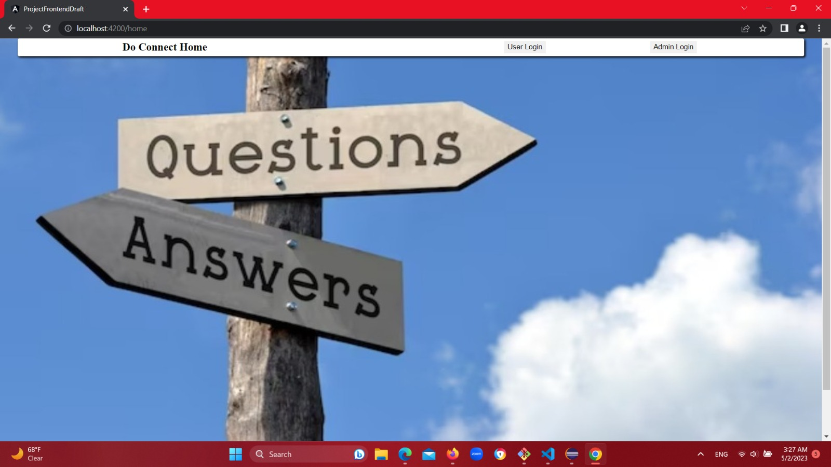
DOCONNECT APP
Welcoming Home Screen.

Slide 4
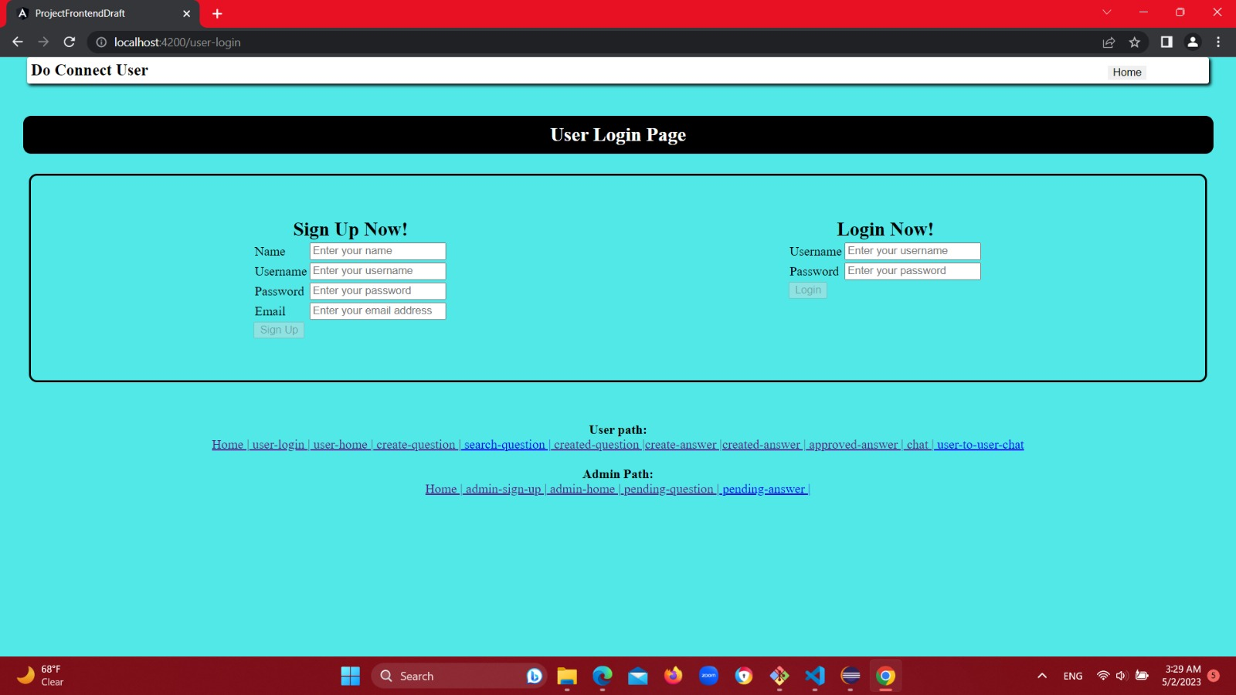
LOGIN/ REGISTRATION SCREEN

Slide 5
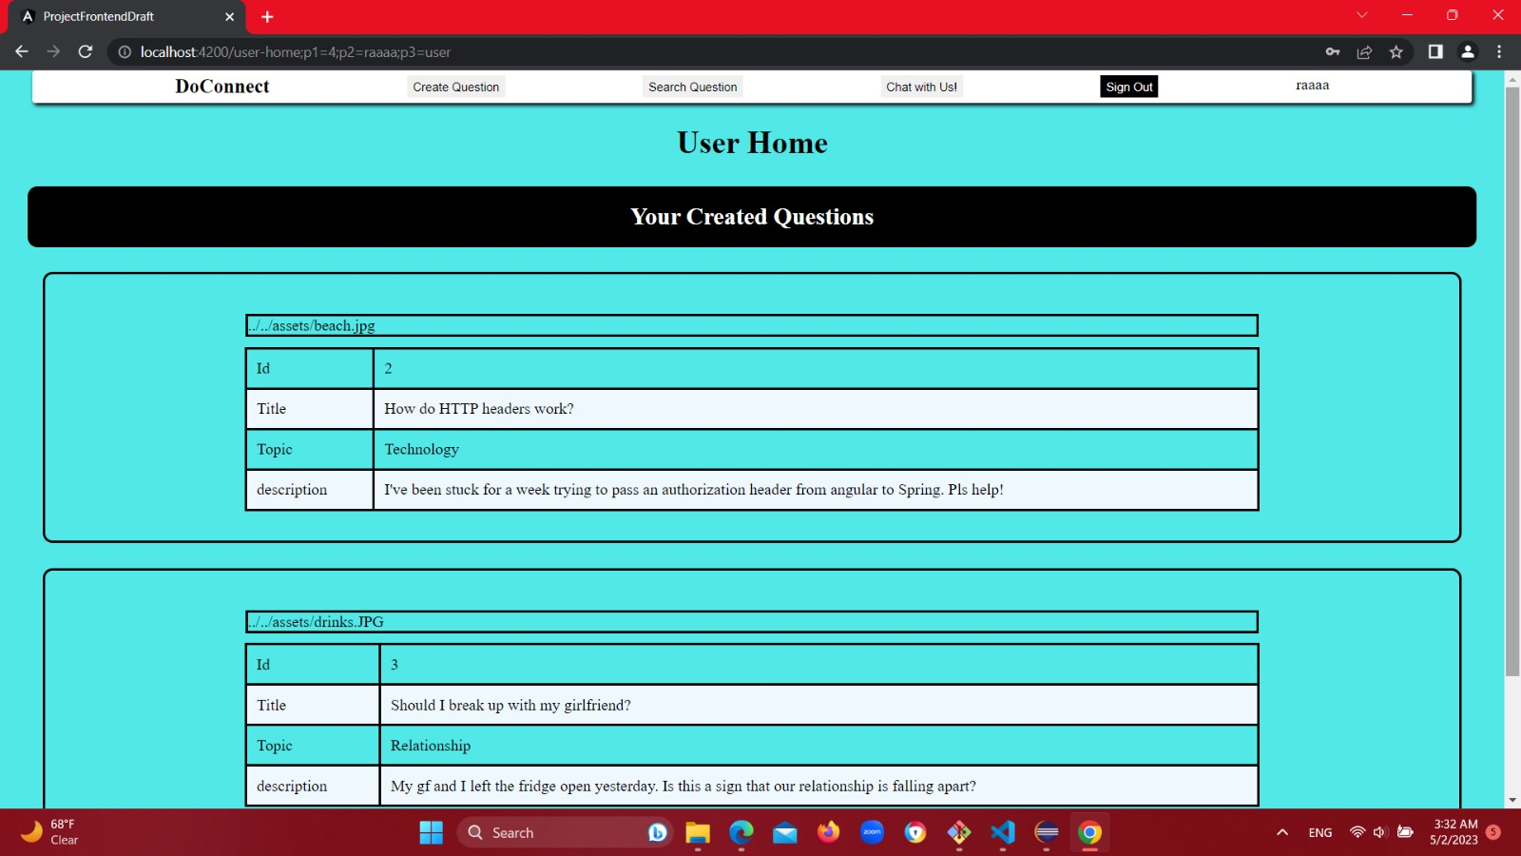
USER LOGIN SCREEN VIEW

Slide 6
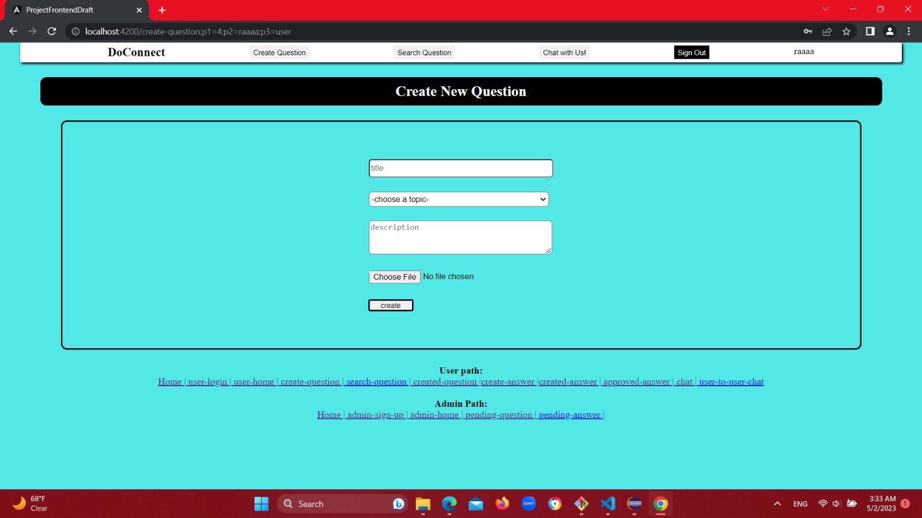
Birth of a Question: Question Creacion Screen

Slide 7
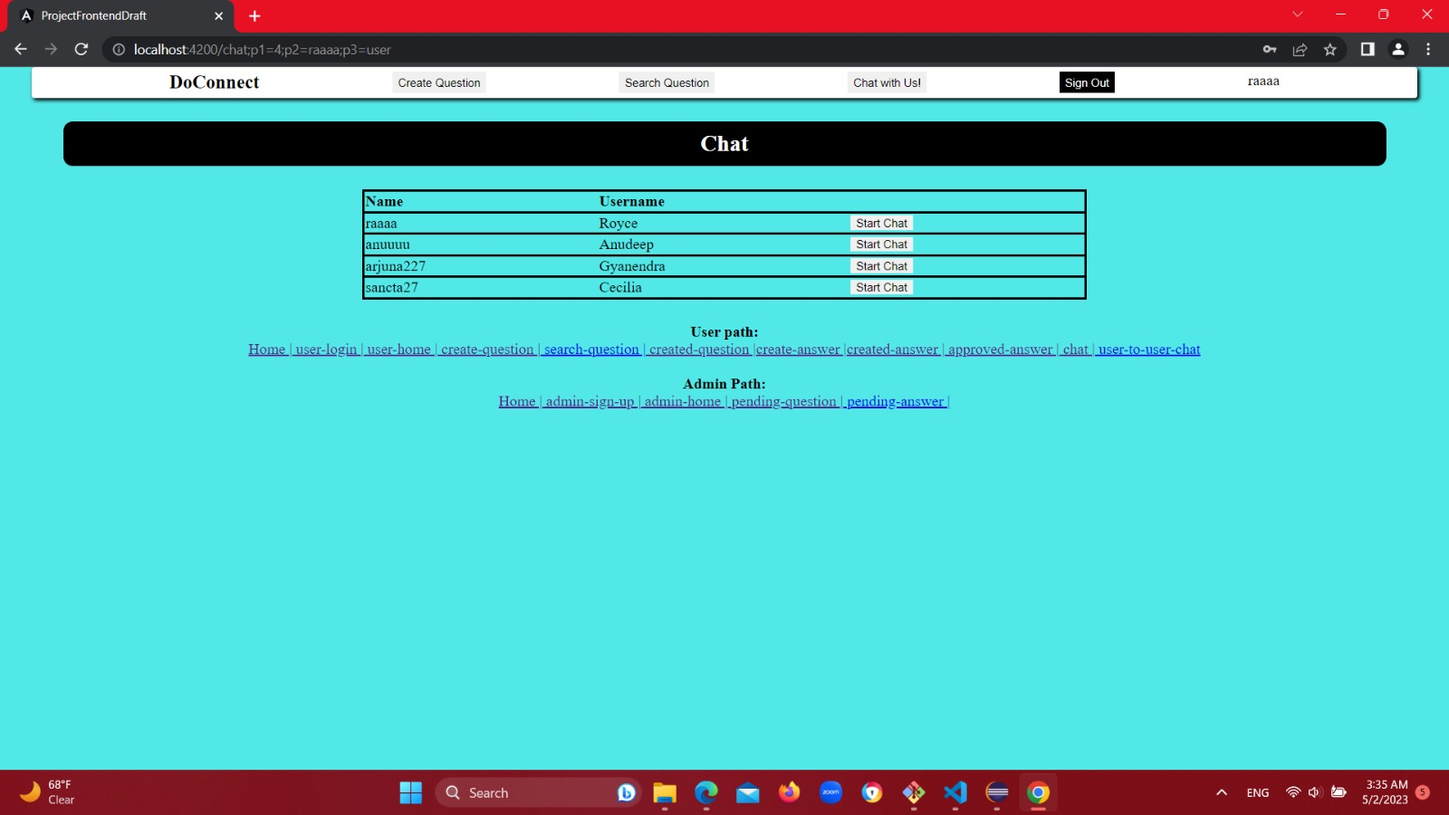
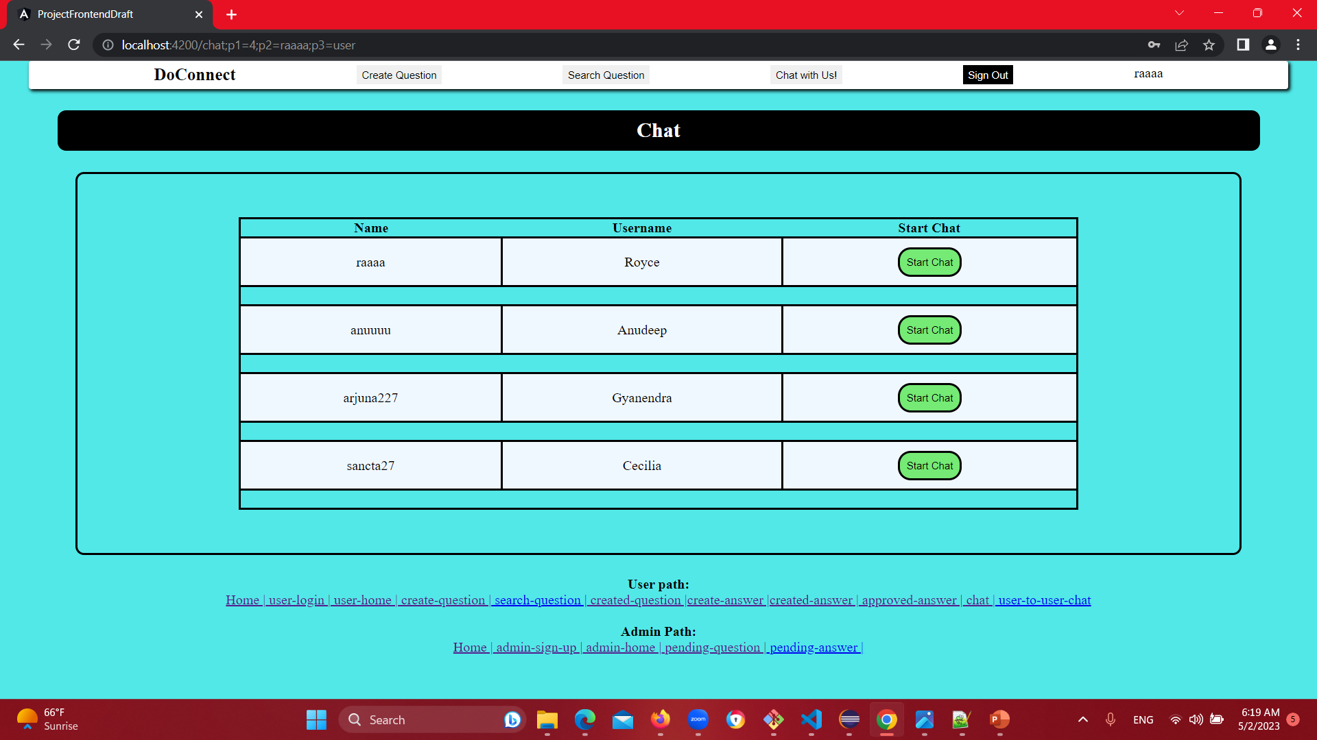
Birth of a Chat: CHAT initialization Screen

Slide 8
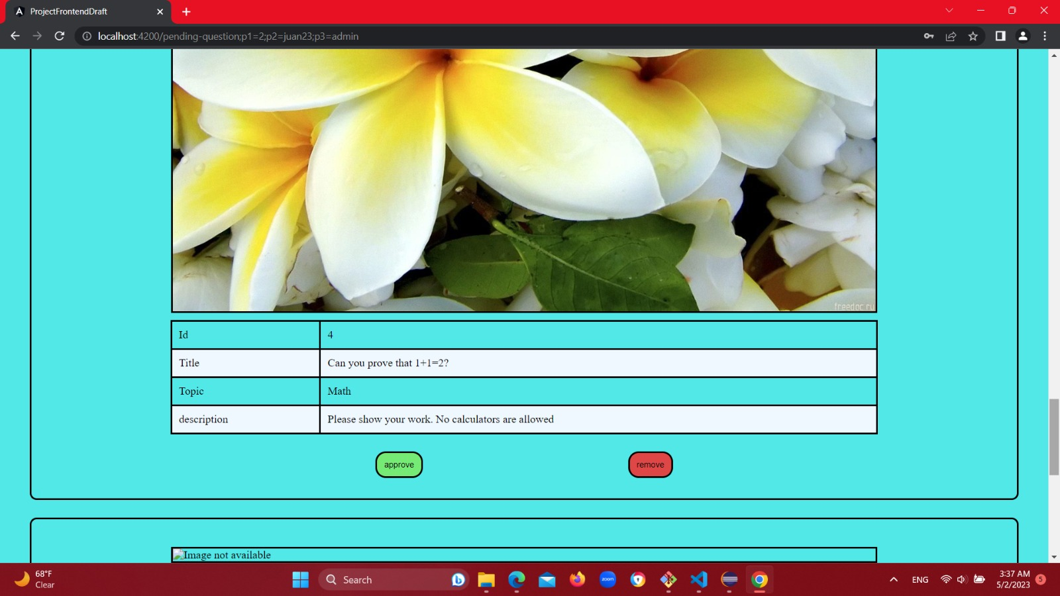
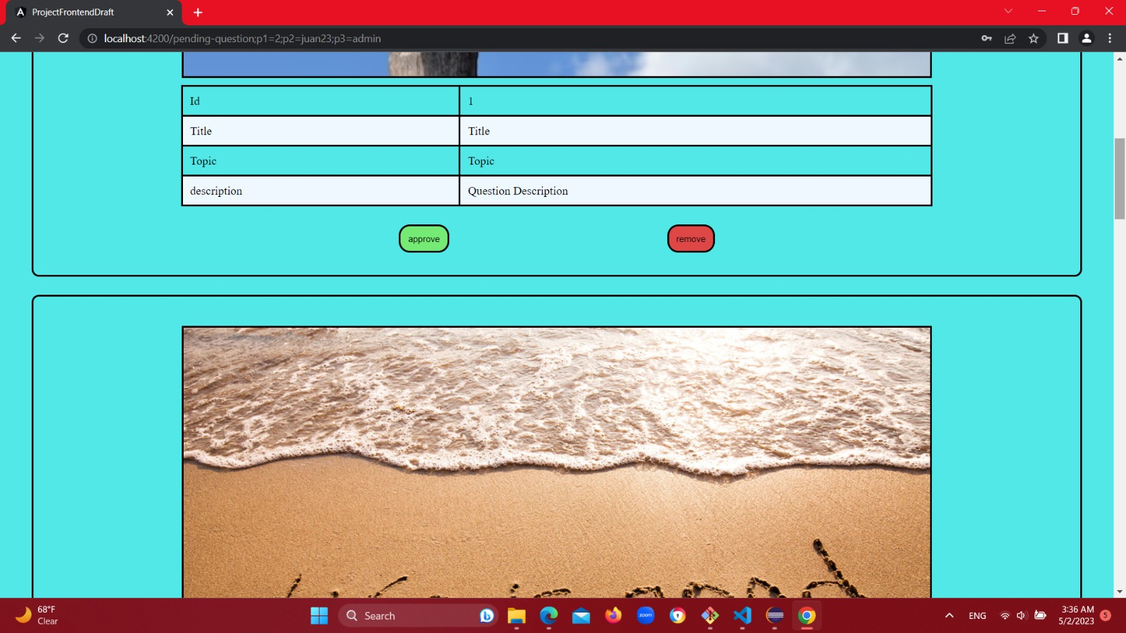
Pending Questions View Sample
Here we can see some pending questions ready to be answered.

Slide 9
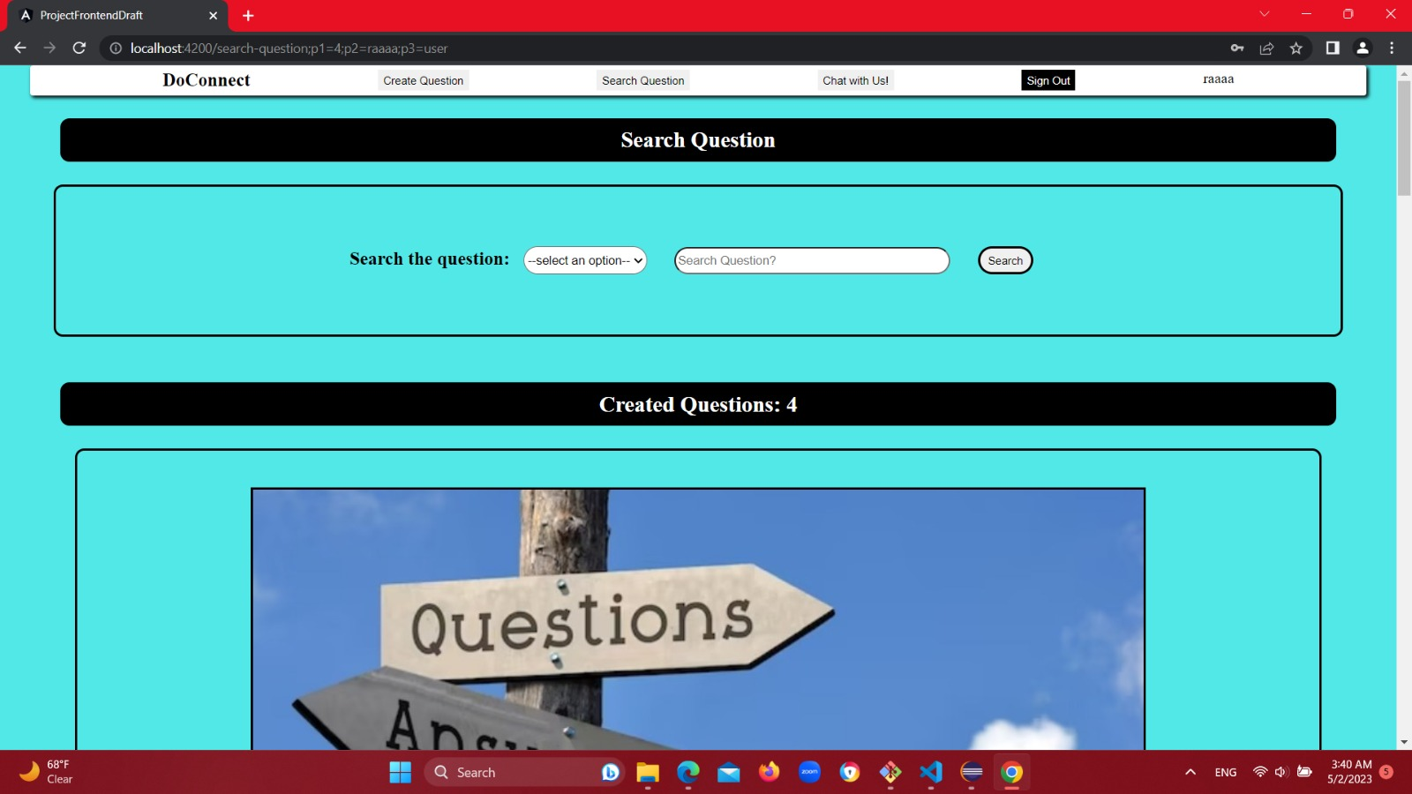
IT'S SEARCH TIME!
Questions to be searched for by our
Certified Experts.

Slide 10
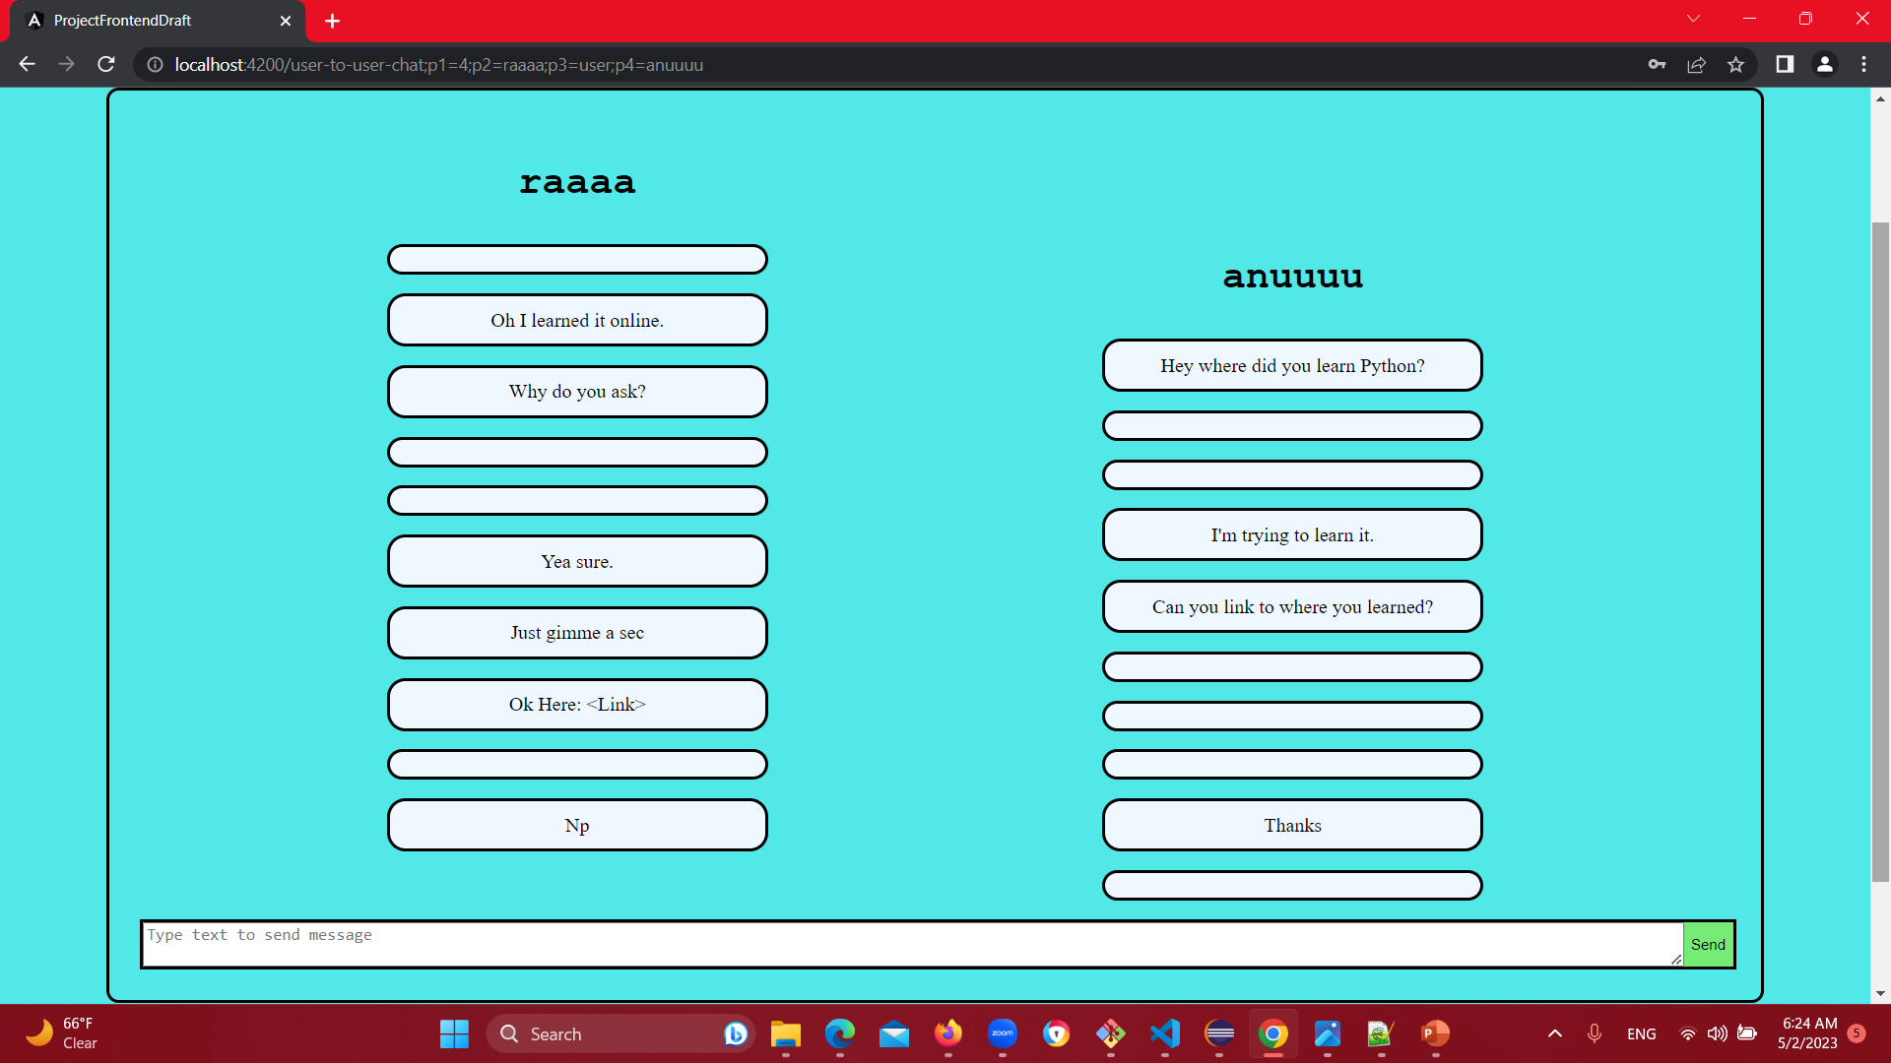

Sneak peek at our Cutting-edge , next gen interactive CHAT feature
DO CONNECT APP
Welcoing Home Screen.
Chat with one of our Experts now!

